Slide 1
Building A Portfolio
A Step-by-Step Guide to Completing an Application for GIS Professional Certification
Education

Slide 2
The Certification Process
Requires submission of a professional portfolio and successful passing of the GISCI Geospatial Core Technical Knowledge Exam^{R}
The portfolio requires completion of all three components (education, experience, & contributions to the profession).

Slide 3

Helpful Tip
Before you Begin
There is no benefit to documenting a high point total. The point total is used only during application assessment and is not noted or reflected in your final certificate. It is unnecessary to expend extensive effort documenting minor achievements unless the point values are needed to meet the minimum.

Slide 4
Request External Official Documentation
Primary materials include:
  Letter from your immediate supervisor
  college transcript(s)
Secondary materials may include:
  certificates of completion / participation
  awards
  publications
  course catalogs, class syllabi, class reports/projects

Slide 5
Removal of Personal Information
All sensitive or personal information (i.e., social security number, drivers license number, maiden name, etc.) should be removed or obscured from any document. If this information is included only the GISCI staff and Review Committee Members will view it.

Slide 6
The Certification Process
Requires completion of all three components (Education, Experience & Contributions to the Profession).
Requires providing proper documentation.

Slide 7

The Educational Achievement Component

Slide 8
The Educational Achievement Component
The Applicant will need a minimum of 30.0 Educational Achievement Points to satisfy this section.
All materials are submitted online. Nothing is submitted via postal mail.

Slide 9
Education Point Schedule
Credential (Degree/certificate) Points
Accredited Course Points
Non-Accredited Course Points
Conference/Webinar Attendance Points

Slide 10
Education Point Schedule: Credential (Degree/certificate) Points
Points earned through successful completion of a formal degree (BA, BS, MA, PhD) or certificate program offered by accredited educational institutions.
Only the highest degree will count towards your point total.

Slide 11
Academic Credential Points
Points awarded:
Masters Degree or PhD 25 points
Bachelors Degree 20 points
Associates Degree 10 points
GIS Certificate 5 points
Enter only the highest degree earned.

Slide 12
Education Point Schedule: Accredited Course Points
Points earned through successful completion of individual courses from an accredited institution.
Includes course through the degree program, workshops, and other formal, documented educational activities whose subject matter relates directly to geographic information technologies.

Slide 13
Education Point Schedule: Accredited Course Points (cont.)
Accredited Course Points represent the total number of hours an academic institution expects a student to spend in and out of class in meeting course assignments.
A 3-credit hour class would have 120 Total Student Activity Hours and would yield 3 Education points.
Qualifying courses include Geography, GIS, remote sensing, databases, data analysis, programming, higher math (especially trig and stat), AutoCAD, computer science, and networking.

Slide 14
Education Point Schedule: Non-Accredited Course Points
Points earned through courses and training taken outside a college or university setting.
Can be software-specific training, such as Esri, AutoCAD, Oracle, or other training
Points are awarded based on the total time spent online or in an instructor-led environment.

Slide 15
Education Point Schedule: Conference/Webinar Attendance
Points are awarded in recognition of the valuable informal learning afforded by participation in meetings and conferences sponsored by professional societies and regional and local user groups.
Points are awarded based on the total number of hours spent online or at a conference.

Slide 16
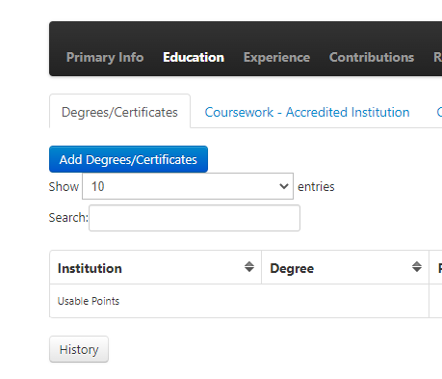
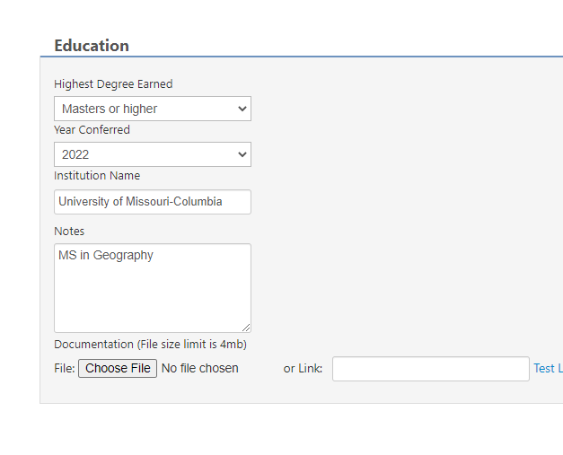
Completing the Education Points Section: Credential Points
Click on ‘Add Degree / Certification’ then use the drop down to add info.
Type in info as appropriate and add your transcript.

Slide 17
Documenting Academic Credential Points
The credential claimed must be found on an original transcript.
If the degree is not listed on the original transcript, a copy of the diploma may be included.
You may submit an unofficial transcript.

Slide 18
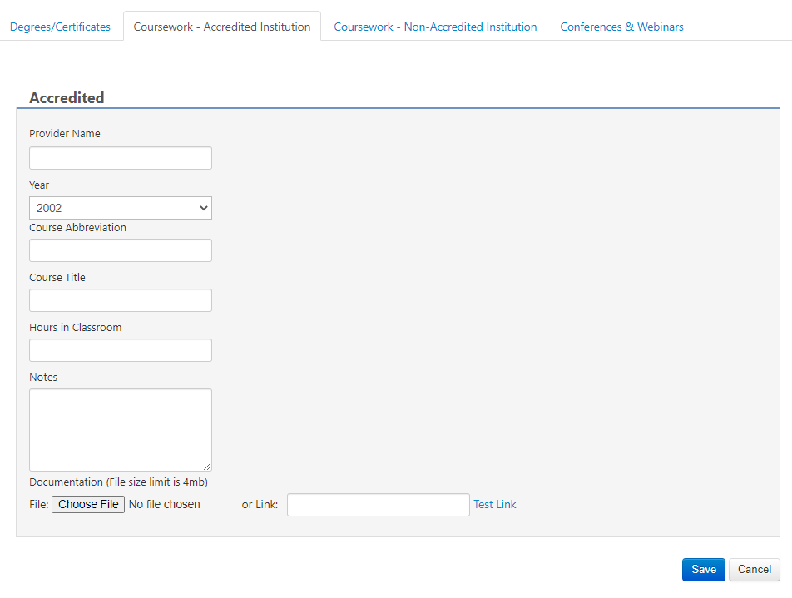
Completing the Education Points Section: Accredited Institute Points
Click on ‘Coursework – Accredited Institution’ then use the menus to add info.
Enter hours in classroom and add documentation. Your existing transcript is fine.

Slide 19
Notes on the Course Points Section
Subject matter must relate directly to geospatial information science or related technology, and applications.
The course subject matter must be subsumed by the “knowledge areas” identified in the University Consortium on Geographic Information Sciences’ (UCGIS) “Body of Knowledge” plus computer programming courses.

Slide 20
Notes on the Course Points Section
All university courses claimed must be found on an original transcript
Courses offered by non-accredited educational institutions such as workshops and vendor training are also acceptable.
Proper documentation of workshops should be supplied (certificates, invoices, rosters, etc.)

Slide 21
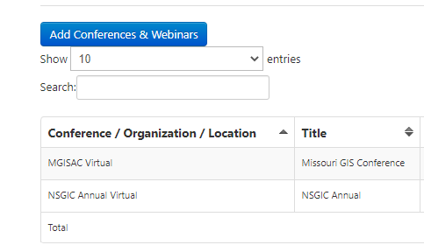
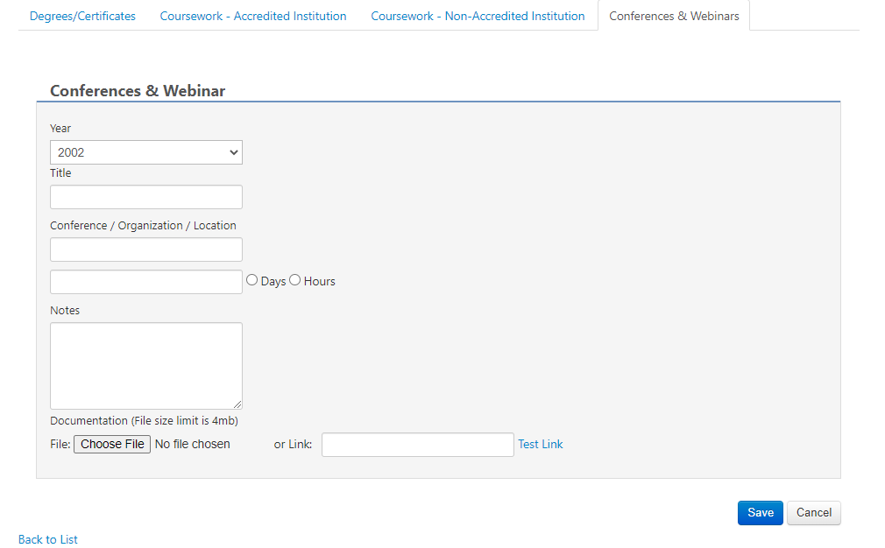
Completing the Education Points Section: Conference & Webinar Points
Click on ‘Add Conferences & Webinars’ then use the menus to add info.
Note days (conference) or hours (webinar) & add documentation

Slide 22
Notes on the Conference & Webinars Points Section
Conference attendance points are a result of the number of total days that the applicant has spent at meetings and conferences sponsored by professional societies and regional and local user groups.
Webinars are determined by the number of hours spent at each event.
Virtual and in-person events qualify for the same amount of points.

Slide 23
Double-Counting Points
Double Counting points is a good thing.
Applicants earn points for courses taken while earning the credential.
Rewards applicants with degrees in GIS or geospatial technology without punishing those who don’t.

Slide 24
Documenting The Educational Achievement Component

Slide 25
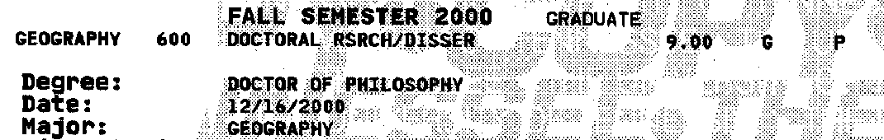
Credential Points and the University Transcript
The degree used to claim credential points should be listed on the transcript. If the degree is not listed, please provide a COPY of the diploma.

Slide 26
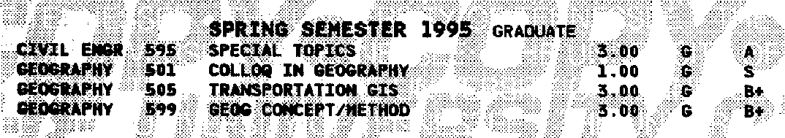
Course Points and the University Transcript
University courses (accredited) need to be found on the included transcript(s).
Transcripts may be unofficial copies. Transcripts may only be marked to remove sensitive information or to highlight the courses that are being claimed.

Slide 27
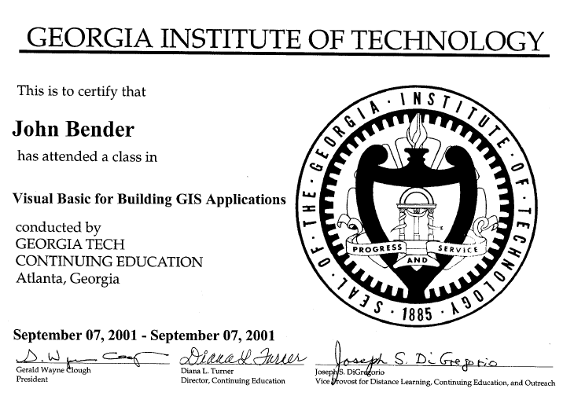
Course Points and Workshop Documentation
Attendance verification needs to be provided for all claimed workshops (over 2 points). If a certificate is not available, submit an invoice, confirmation notice or a letter from the hosting organization.

Slide 28
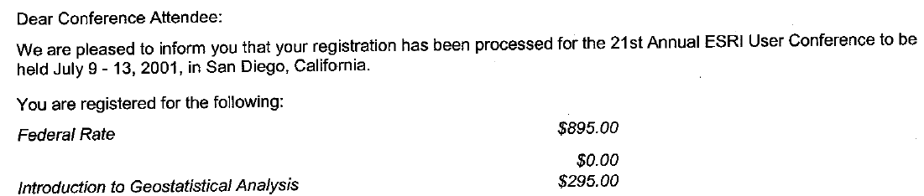
Conference Attendance Documentation
Conference Attendance documentation is not mandatory, but applicants may submit documentation for all point claims. Documentation can include a confirmation letter, certificate, name badge, or any other materials that identify the event and verify attendance.

Slide 29
You have now completed the Education Section of your Portfolio
But you aren’t done yet! Continue with the other sections.

Slide 30
Any Questions?
Contact GISCI
www.gisci.org
Email: info@gisci.org
Phone 847-824-7768
Fax 847-824-6363

